Slide 1

R Shiny

Slide 2

Introduction
Web Applications with R Shiny
Requires the Shiny Package in R
Check Out R Shiny Cheat Sheet
Gallery of Shiny Applications
Deployable by shinyapps.io

Slide 3
Introduction
Web Programming Basics
HTML: Controls the Organization of the Web Page and Gives Markup Instructions
CSS: Controls the Style
Javascript: Interactivity

Slide 4
Introduction
Planning What You Want to Do
User Controls ____________
Output Given is ___________
R Code I Need is __________

Slide 5
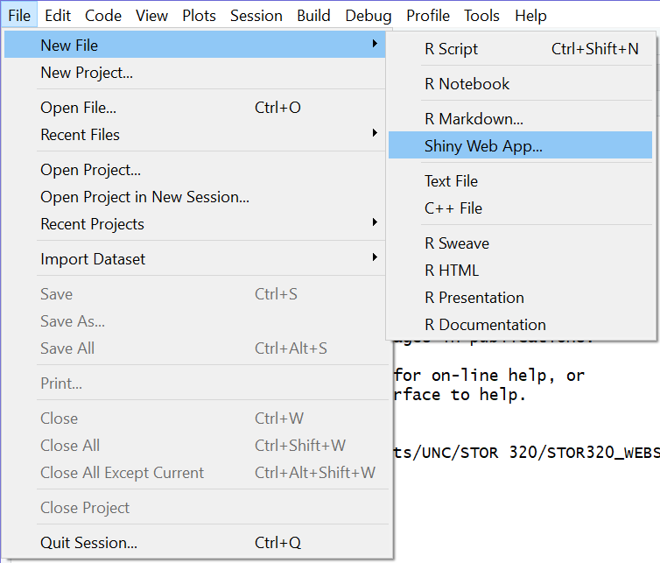
Getting Started
Step 1: Install Shiny Package
Step 2: Load the Library
Step 3: Create a New Shiny App
> install.packages(“shiny”)
> library(shiny)

Slide 6
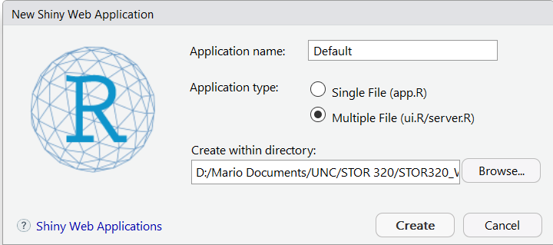
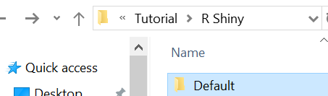
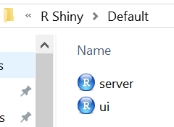
Getting Started
Step 4: Initiate Your Shiny App
Select

Slide 7
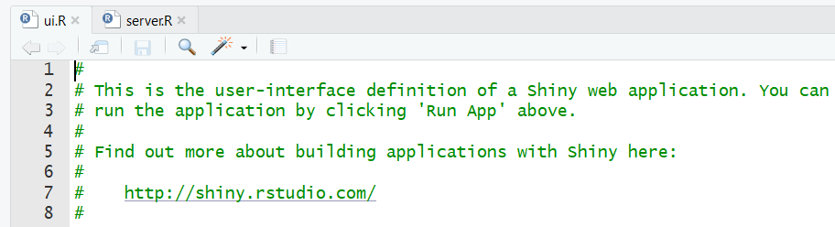
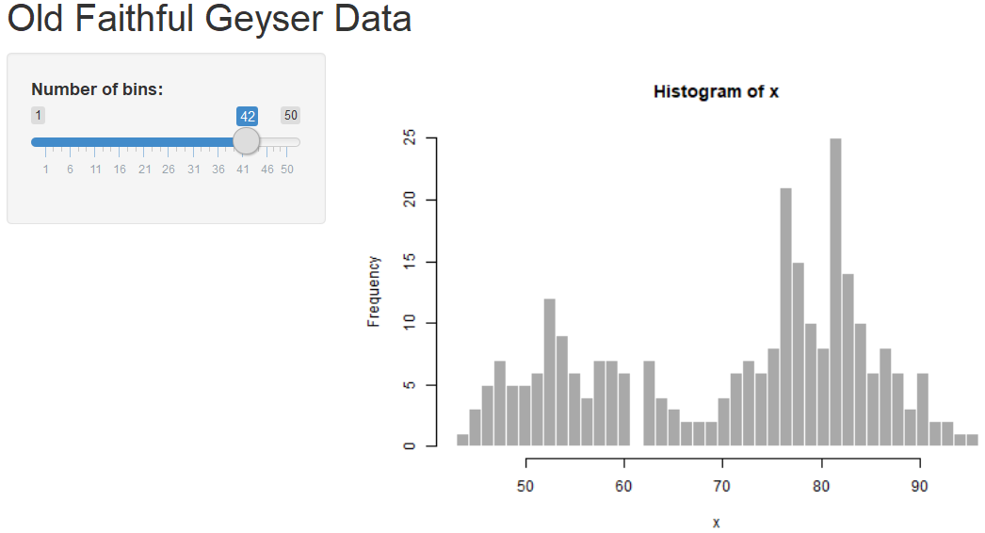
Getting Started
Step 5: Run the Shiny App
Step 6: Play With the App
Look in Top Right Corner

Slide 8

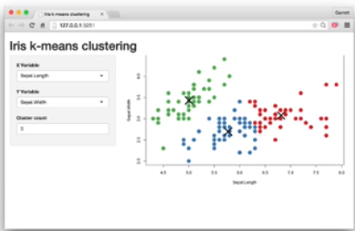

Shiny Fundamentals
How it Works?
Communication Between Your Computer and Your App
Sharing Through the Cloud From a Web Based Server

Slide 9


Shiny Fundamentals
Two Components in R
ui.R
User Interface
Written in HTML
Specify Inputs
Displays Outputs
server.R
Instructions in R
Uses Inputs
Computations
Graphics
Models
Generates Outputs

Slide 10
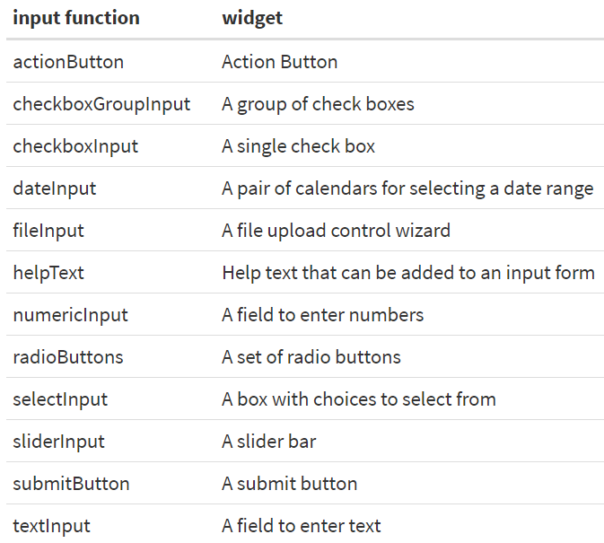
Shiny Fundamentals
Types of Inputs (UI)
What User Can Control
List of Possible Widgets
Shiny Widget Gallery

Slide 11
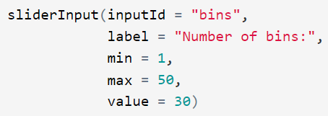
Shiny Fundamentals
Types of Inputs (UI)
First Two Arguments
inputId = Unique Variable Name So Server Knows When to Use It
label = Text That is Seen in Widget to Guide User
Other Arguments Depend on the Type of Input Function

Slide 12
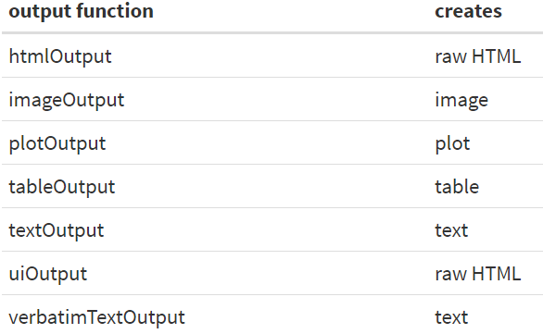
Shiny Fundamentals
Types of Outputs (UI)
What User Can See
List of Possible Output Types

Slide 13

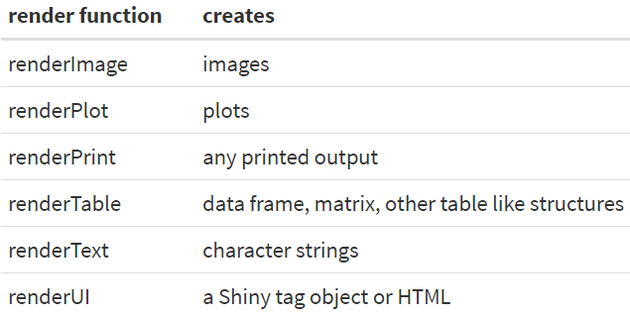
Shiny Fundamentals
Types of Outputs (UI)
outputId = Connected to Output Created on the Server Side
Render Functions Make These Outputs on the Server Side

Slide 14
Gapminder Shiny App
Instructions
Step 1: Download Tutorial
Step 2: Unzip Folder
Step 3: Open Both R Files in Gapminder_Start
Step 4: Install Gapminder
Step 5: Run the App
Gapminder Data
Used in Chapter 20 (R4DS)
Non-Profit Project Promoting a Fact-based World
Popularized by Hans Rosling
Packaged in R
> install.packages(“gapminder”)
> library(gapminder)

Slide 15
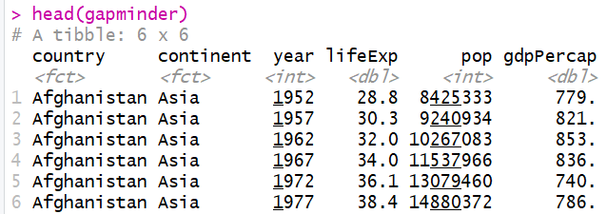
Gapminder Shiny App
Data Content in Gapminder
Begin Using the App
Enter Name, Select Countries, Select Variable, and Submit
Observe the Use of CSS Code
Observe the tabsetPanel Style
Observe the Use of renderUI with uiOutput

Slide 16
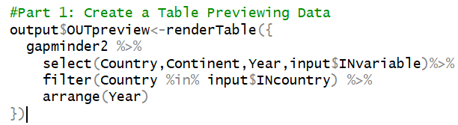
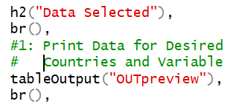
Gapminder Shiny App
Part 1: Data Selected
Modification for server.R
Modification for ui.R
Run the Shiny App
Close the Shiny App

Slide 17
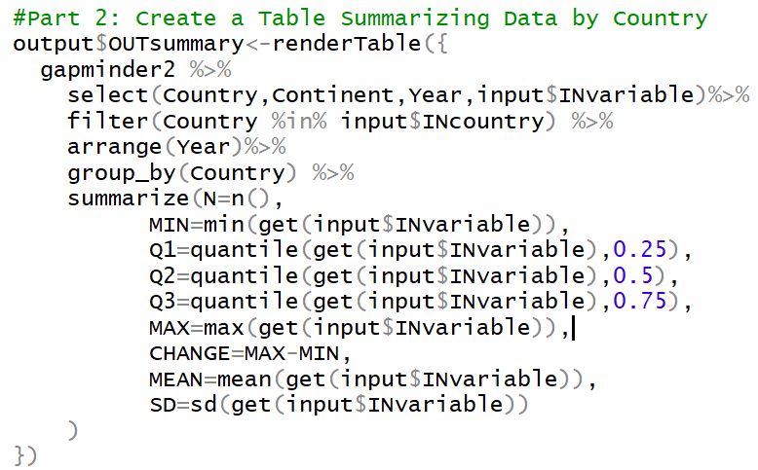
Gapminder Shiny App
Part 2: Data Summary
Modification for server.R

Slide 18
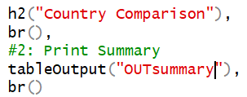
Gapminder Shiny App
Close the Shiny App
Part 2: Data Summary (Continued)
Modification for ui.R
Run the Shiny App
Notice the get() Function
Input is a Character String
Need to Drop the Quotes
Evaluates Functions on The Variable Object

Slide 19
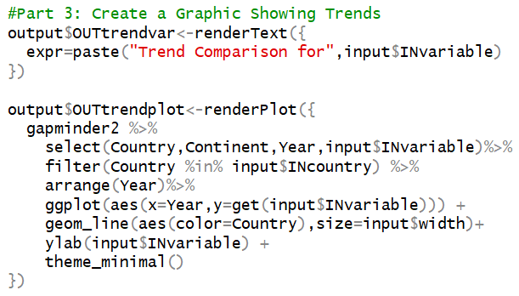
Gapminder Shiny App
Part 3: Trend Plots
Modification for server.R
Notice: We are Going to Control the Width of the Lines

Slide 20
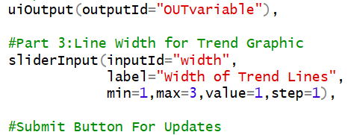
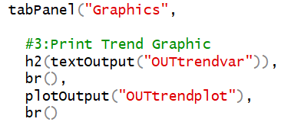
Gapminder Shiny App
Part 3: Trend Plots (Continued)
Modification for ui.R
Creation of Slider Input
Displaying Graphic Output
Run the Shiny App

Slide 21
R Shiny Tutorials
Official 3 Part Video Tutorial
Official Shiny Cheat Sheet
Video Tutorials by Abhinav Agrawal
Video Combining Shiny with Rmd
Video Tutorial on Shiny Dashboard
Video Tutorials by Johns Hopkins Data Science Lab Produced by Brian Caffo

Slide 22
Closing
Disperse and Make Reasonable Decisions

